Slide 1
SQL Programming
Synonyms

Slide 2
Module 06: Synonyms Page A-1: Intro
In this module we introduce yet another non-standard feature: synonyms.
Webster’s defines synonym as: “one of two or more words or expressions of the same language that have the same or nearly the same meaning in some or all senses” (Merriam-Webster: http://www.merriam-webster.com)
I think of synonyms as simply words that mean the same thing. In geek-speak I’d say that we have two words, ie. pointers that reference the same object (concept).
In the world of Oracle databases, synonyms allow us to refer to database objects by more than one name.
So let’s get started, …

Slide 3
Module 06: Synonyms Page B-1: Column Aliases
We’ve used aliases in the SELECT statement to rename columns in the result table.
This feature came in handy when we were performing calculations and we wanted a more descriptive name for the result column. For example:
SELECT price, price *.07 AS tax
FROM products;
On other occasions we used column aliases to rename result columns whose base column names were somewhat cryptic.
SELECT majr AS “Major Code”
FROM students;

Slide 4
Module 06: Synonyms Page B-2: Table Aliases
We’ll also see in a future module how to use table aliases in the FROM clause to provide an abbreviation for our table names, so that our SQL code doesn’t become too ‘bulky’.
Without table aliases:
SELECT l_employees.employee_id,
l_employees.dept,
l_employees.yr,
l_employees.dob
FROM l_employees, l_managers
WHERE l_employees.dob <
l_managers.dob
With table aliases:
SELECT emp.employee_id, emp.dept,
emp.yr, emp.dob
FROM l_employees emp, l_managers mgr
WHERE emp.dob < mgr.dob

Slide 5
Module 06: Synonyms Page B-3: Aliases Justified
And if you were confronted with this question on an exam:
What are some of the benefits for using column and table aliases?
I’m sure you could come up with a few more reasons to use aliases in addition to the few we just identified.

Slide 6
Module 06: Synonyms Page C-1: Standards
Let’s change gears for a minute and think back on some comments I made earlier in the course about standards.
Way back in Module 01 for the Level 2 class I made this obscure comment: My preference when designing database systems is to define a set of standards for the application. One of the standards would be to define, for each table, a unique 3- or 4-character alias. Whenever a table alias is needed in an application, the programmer must (according to our standards) use the predefined abbreviation (alias).
The only point I want to make at this juncture is this: Standards help to ‘standardize’ processes. They provide a systematic way for doing things, and once a system is in place it can be measured, and improved.
Without standards, things are done in a haphazard fashion. Too many questions get asked during the project that could have been addressed with a set of standards.

Slide 7
Module 06: Synonyms Page C-2: Standards
So if we accept the premise that standards are good.
And we decide that one of our project standards should be to define a set of table aliases that can be used throughout the application, ….
Then
Shouldn’t there be some way to record these ‘aliases’ in the database so that we don’t have to define them in each SQL program that we write?

Slide 8
Module 06: Synonyms Page C-3: Standards
So if we accept the premise that standards are good.
And we decide that one of our project standards should be to define a set of table aliases that can be used throughout the application….
Then
Shouldn’t there be some way to record these ‘aliases’ in the database so that we don’t have to define them in each SQL program that we write?
You would think, …
But the SQL standard does not provide a means for us to do so.

Slide 9
Module 06: Synonyms Page C-4: Standards
So if we accept the premise that standards are good.
And we decide that one of our project standards should be to define a set of table aliases that can be used throughout the application….
Then
Shouldn’t there be some way to record these ‘aliases’ in the database so that we don’t have to define them in each SQL program that we write?
You would think, …
But the SQL standard does not provide a means for us to do so.
The good news is that most vendor implementations of SQL do provide some means for ‘defining aliases’.

Slide 10
Module 06: Synonyms Page D-1: Synonyms
In Oracle, these ‘permanent’ aliases are referred to as synonyms.
And Oracle permits us to define synonyms for: tables, views, sequences, and program units.
Program units are beyond the scope of this class, but the simple way to think about them is that they are computer programs that are stored in the database, and hence available to anyone using that system. Among other things, program units allow programmers to define their own functions.
But like I said, that’s another story, …

Slide 11
Module 06: Synonyms Page D-2: Synonyms
Synonyms are themselves schema objects, ie. database structures, and they are created with the CREATE command, and they are removed with the DROP command.
The syntax for creating synonyms is:
CREATE SYNONYM synonym_name
FOR object_name
And the syntax for dropping synonyms is
DROP SYNONYM synonym_name

Slide 12
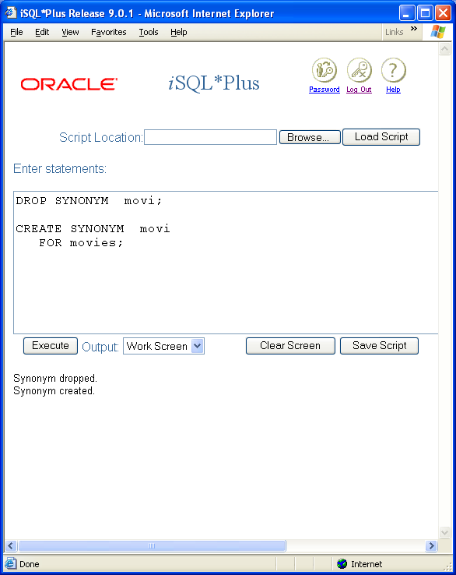
Module 06: Synonyms Page D-3: Synonyms
Synonyms are schema objects, ie. database structures, and they are created with the CREATE command, and they are removed with the DROP command.
The syntax for creating synonyms is:
CREATE SYNONYM synonym_name
FOR object_name
And the syntax for dropping synonyms is
DROP SYNONYM synonym_name
And I can use this synonym anywhere in my schema.

Slide 13
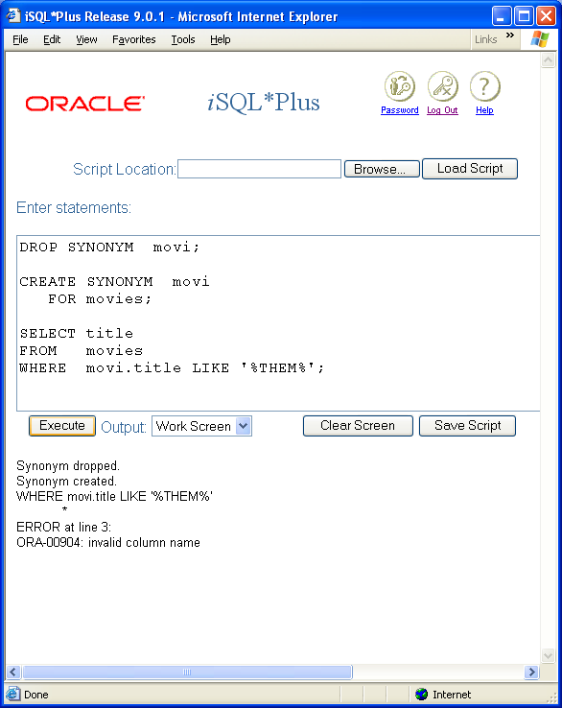
Module 06: Synonyms Page D-4: Synonyms
We can use this synonym now, almost anytime, to refer to the movies table.
What we can’t do though, is in the middle of a statement, combine an object name with its synonym.

Slide 14
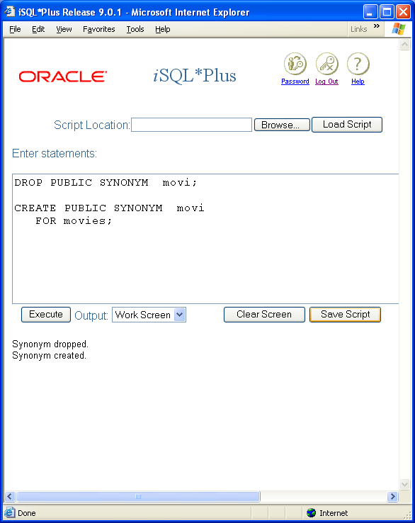
Module 06: Synonyms Page D-5: Public Synonyms
The CREATE SYNONYM statement creates a private synonym. This synonym is available only to me (the owner of the synonym), within my ‘schema space’.
If I want to share this synonym with my user community, then I need to have declared it as a public synonym.
CREATE PUBLIC SYNONYM synonym_name
FOR object_name

Slide 15
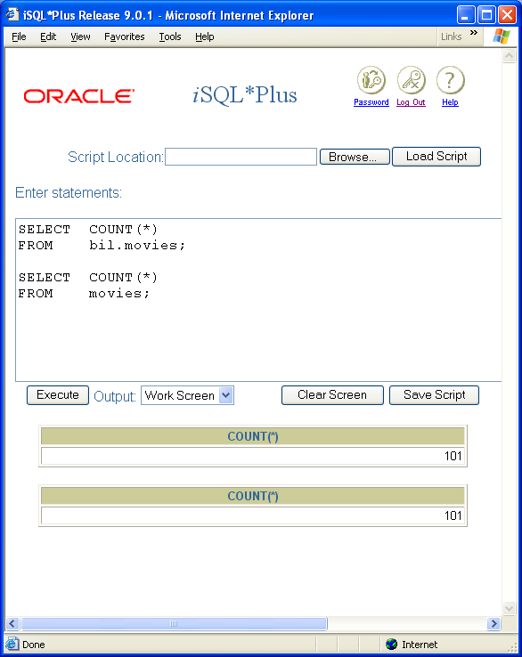
Module 06: Synonyms Page D-6: Public Synonyms
Once a public synonym has been set up, everyone on the database system can refer to the object simply by that synonym.
After I’ve made the movies table public, anyone can read it, by an explicit, qualified reference to my schema and table name.
SELECT COUNT(*)
FROM bil.movies;
Once I’ve established a public synonym, the user community no longer needs to ‘qualify’ the table name with my schema name.
SELECT COUNT(*)
FROM movies;

Slide 16
Module 06: Synonyms Page T-1: Terminology
Aliases
Synonyms
CREATE SYNONYM,
CREATE PUBLIC SYNONYM
DROP SYNONYM

Slide 17
Module 06: Synonyms Page Z-1: End Notes
Please drop me an email if you noticed any errors in this module. I’d also appreciate reading your comments, criticisms, and or suggestions as to how this module could be improved.
Were there any gaps in the information that was presented (ie. ‘leaps of faith’)?
Was any section unclear?
Did I happen to do a good job? ☺
Thanks,
bil

Slide 18
That’s All

